Slide 1

Introduction to AI/Deep Learning and their libraries
Presented By –
Dr. Dinesh Gupta
Group Leader, Translational Bioinformatics Group
ICGEB, New Delhi

Slide 2
What is deep learning?
The field of artificial intelligence is essentially when machines can do tasks that typically require human intelligence. It encompasses machine learning, where machines can learn by experience and acquire skills without human involvement.
Deep learning is a subset of machine learning where artificial neural networks, algorithms inspired by the human brain, learn from large amount of data.
Deep learning allows machines to solve complex problems even when using a data set that is very diverse, unstructured and inter-connected. The more deep learning algorithm learn, the better the perform.

Slide 3
Definition of Artificial Neural Networks:
Artificial neural networks are multi-layer fully connected neural nets and consists of an input layer, multiple hidden layers, and an output layer.
Every node in one layer is connected to every other node in next layer and the network becomes deeper by increasing the number of hidden layers.

Slide 4
Input layer
Hidden layer 2
Output layer
Hidden layer 1
Notes:
Artificial neural networks are multi-layer fully connected neural nets as shown in this figure. They consist of an input layer, multiple hidden layers, and an output layer. Every node in one layer is connected to every other node in the next layer. We make the network deeper by increasing the number of hidden layers.

Slide 5

x1
w1
x2
w2
z
y1
w3
f
x3
w4
xn
Forward pass
Notes:
This figure shows tha a given node takes the weighted sum of its inputs, and passes it through a non-linear activation function. This is the output of the node, which then becomes the input of another node in the next layer. The signal flows from left to right, and the final output is calculated by performing this procedure for all the nodes. Training this deep neural network means learning the weights associated with all the edges.

Slide 6
Training :
Primarily, randomly initialize the weights for all the nodes.
For every training example, perform a forward pass using the current weights, and calculate the output of each node going from left to right. The final output is the value of the last node.
Compare the final output with the actual target in the training data, and measure the error using a loss function.
Perform a backward pass from right to left and propagate the error to every individual node using backpropagation. Calculate each weight’s contribution to the error, and adjust the weights accordingly using gradient descent. Propagate the error gradients back starting from the last layer.

Slide 7
Why do we need to go deep in the first place?
Layer of ANN performs non-linear transformation of its input from one vector space to another.
For example, in some classification problems the input data in its given form is not separable. And by performing non-linear transformations at each layer, we project the input to a new vector space, and draw a complex decision boundary to separate the classes.

Slide 8
F(x.W)
Non-linear transformation
Input space
Projected Space

Slide 9
A few concrete examples :
Classification:
Detect faces, identify peoples in images, recognized facial expressions (angry, joyful)
Identify objects in images (stop signs, pedestrians, lane markers …)
Recognise gestures in video
Detect voices, identify speakers, transcribe speech to text, recognize sentiment in voices
Classify text as spam (in emails), or fraudulent (in insurance claims), recognize sentiment in text

Slide 10
Clustering :
Search: Comparison documents, images or sounds to surface similar items
Anomaly detection: The flipside of detecting similarities is detecting anomalies, or unusual behavior. In many cases, unusual behavior correlates highly with things you want to detect and prevent, such as fraud.

Slide 11
Predictive analytics: Regressions
Health breakdowns (strokes, heart attacks based on vital stats and data from wearables)
Customer churn (predicting the likelihood that a customer will leave, based on web activity and metadata)
Deep learning is able to establish correlations between present events and future events.

Slide 12
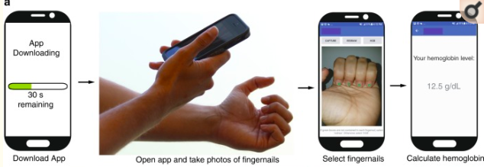
Few examples of deep learning applications in biology:
Mannino and Coworkers (2018) developed a smartphone app for non-invasive detection of anemia using patient sourced photos of nails.

Slide 13
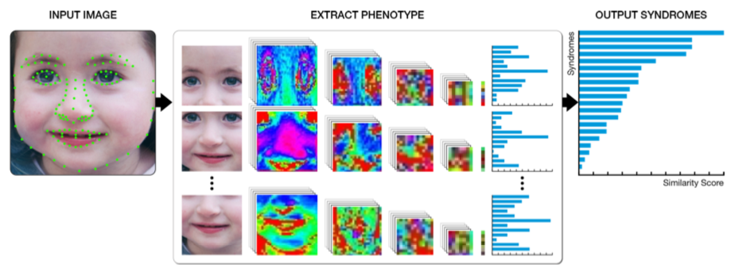
Yaron Gurovih and coworkers (2018) developed a facial image analysis framework DeepGestalt, using computer vision and deep learning algorithms, that qualnitifies similarities to hundreds of syndromes.

Slide 14
Various publicly available deep learning software
Caffe
Tensorflow
PyTorch
Keras
Theano

Slide 15
Introduction to tensorflow:
Currently, the most famous deep learning library in the world is TensorFlow which is developed by Google’s Brain Team. It is called Tensorflow because it takes input as a multi-dimensional array, also known as tensors.
Its architecture works in three parts:
Preprocessing the data
Build the model
Train and estimate the model

Slide 16
There are numerous components that go into making TensorFlow. The two standout ones are:
TensorBoard: Helps in effective data visualization using data flow graphs
TensorFlow: Useful for rapid deployment of new algorithms/experiments
The flexible architecture of TensorFlow enables us to deploy our deep learning models on one or more CPUs (as well as GPUs). Below are a few popular use cases of TensorFlow:
Text-based applications: Language detection, text summarization
Image recognition: Image captioning, face recognition, object detection
Sound recognition
Time series analysis
Video analysis

Slide 17

Practical:
The tf.layers module of Tensorflow provides a high-level API that makes it easy to construct a neural network. It provides methods that facilitate the creation of dense (fully connected) layers and convolutional layers, adding activation functions, and applying dropout regularization.
We will use layers to build a convolutional neural network model to recognize the handwritten digits in the MNIST data set.
The MNIST dataset comprises 60,000 training examples and 10,000 test examples of the handwritten digits 0–9, formatted as 28x28-pixel monochrome images.

Slide 18
Introduction to Convolution Neural Networks :
Convolutional neural networks (CNNs) are the current state-of-the-art model architecture for image classification tasks. CNNs apply a series of filters to the raw pixel data of an image to extract and learn higher-level features, which the model can then use for classification. CNNs generally have four steps:
Convolution
Pooling
Flattening
Full connection

Slide 19
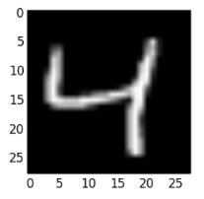
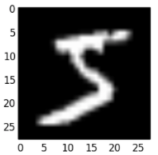
MNIST Dataset
Output
(Labelled images)
FOUR
Methodology for image classification using CNNs
Notes:
All these four steps are described in the above figure. First convolution is applied on the input data using a convolution filter to produce a feature map of the image.
Pooling layers provide an approach to down sampling feature maps by summarizing the presence of features in patches of the feature map. Two common pooling methods are average pooling and max pooling that summarize the average presence of a feature and the most activated presence of a feature respectively.
Flattening is the process of converting all the resultant 2 dimensional arrays into a single long continuous linear vector.
And the last step is to full connection of all the layers to get the output.

Slide 20
Thank You

